Slide 1
Final Project
Integrating jenkins with Git with CI/CD Pipeline.
Presented by :-
Himanshu Kumar Singh

Slide 2
Jenkines:-
it is open-source.
it is used for CI/CD pipeline.
CI=Continous Intigration
CD==Continous Delivery/ Deployment.
it was originally devolped as the fork of hudson project.
after doing this jenkins becomes most popular for CI/CD tool.
jenkins supports various programming language.
jenkins supports different vcs.
Note:- jenkins provides us the platform for automating the building, testing, and deployment of the software application.

Slide 3
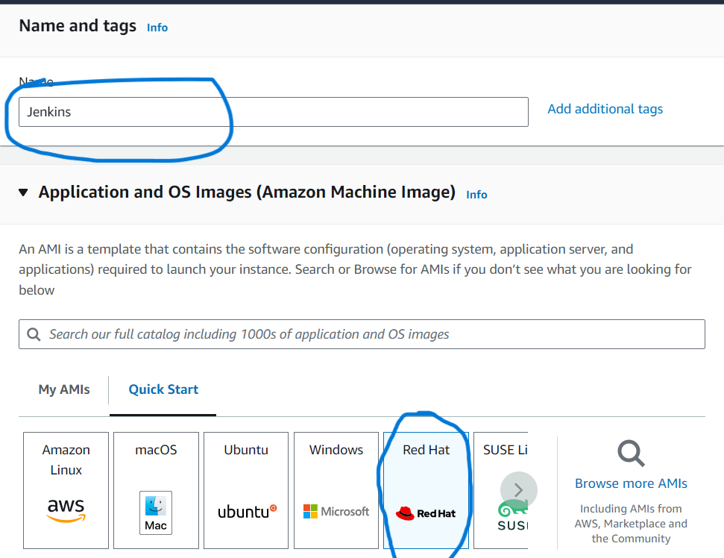
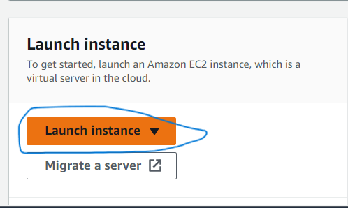
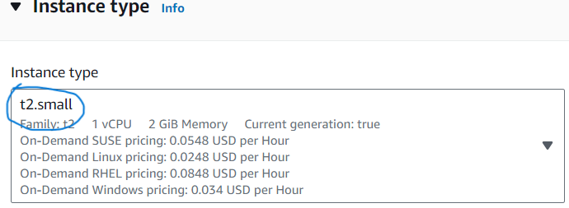
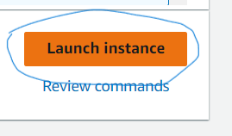
Step 1:-
Launch an instance:-
Redhat ami:-
T2.small:-
Allow port no. 8080:-
2.
1.
3.
4.

Slide 4
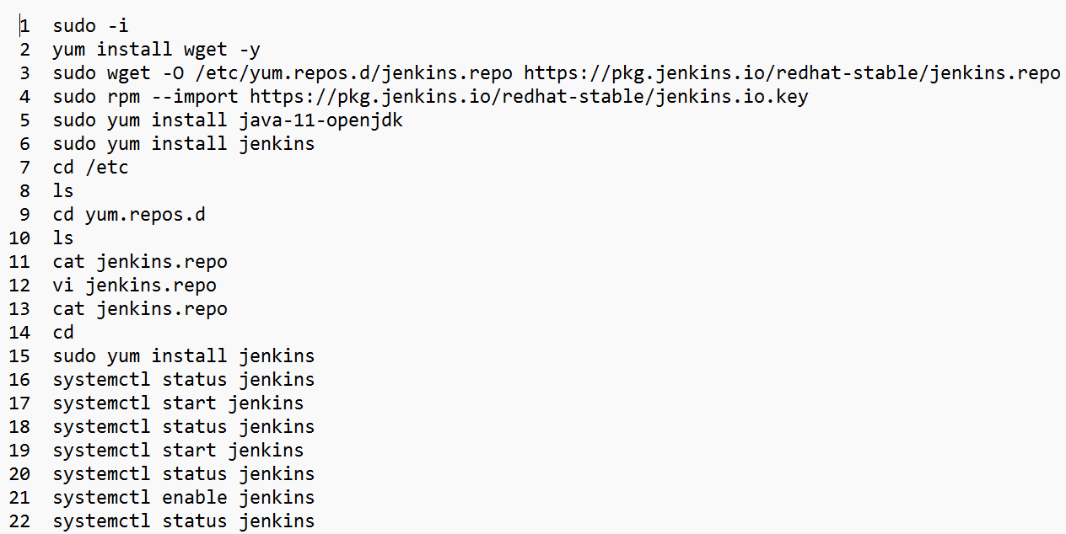
Step 2:-
Now install Jenkins in Machine.
Follow Step 1 to 22 to install Jenkins Sccussfully in your Machine.

Slide 5
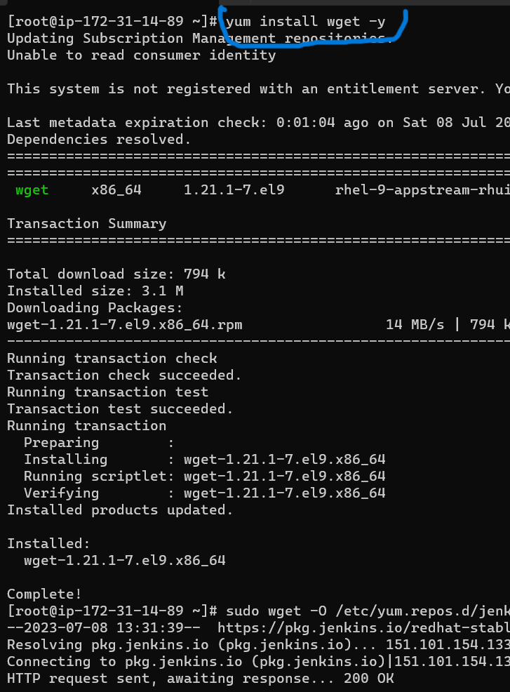
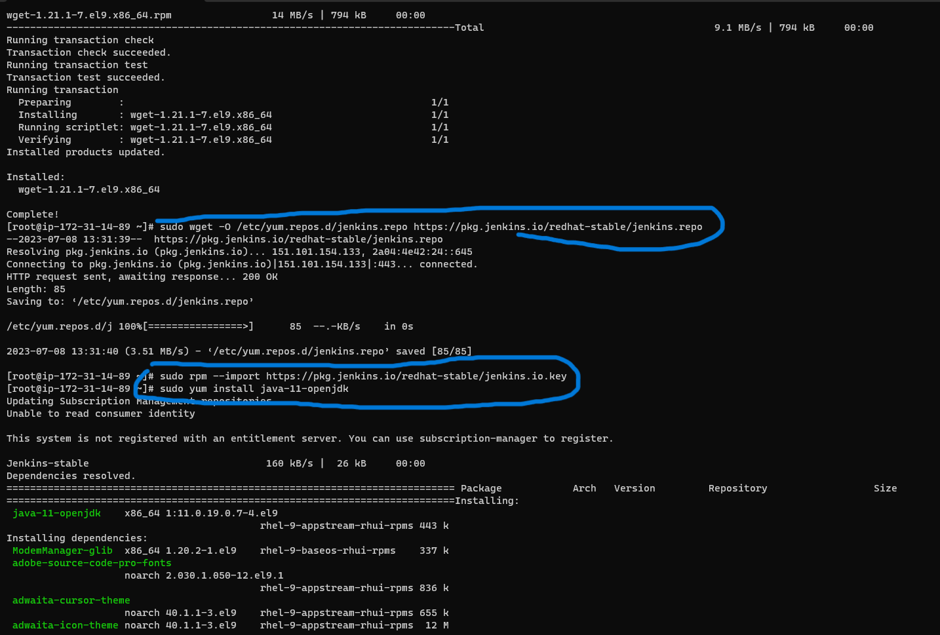
Step 3:-
Downloads Jenkins in repos Directory.
And Downloads latest Java

Slide 6
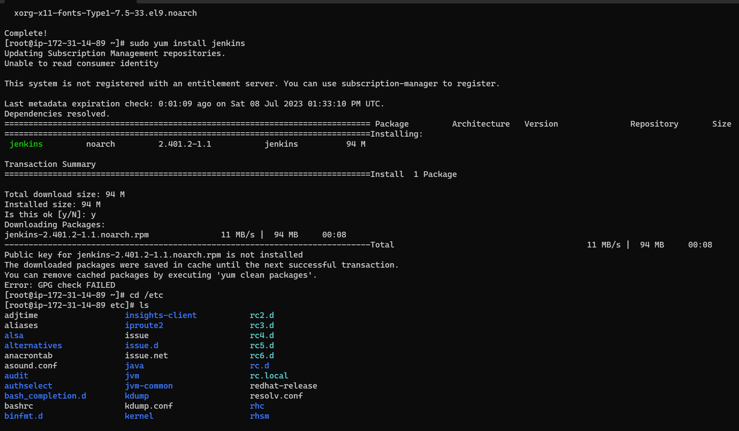
Step 4:-
install jenkins
Here GPG check failed

Slide 7
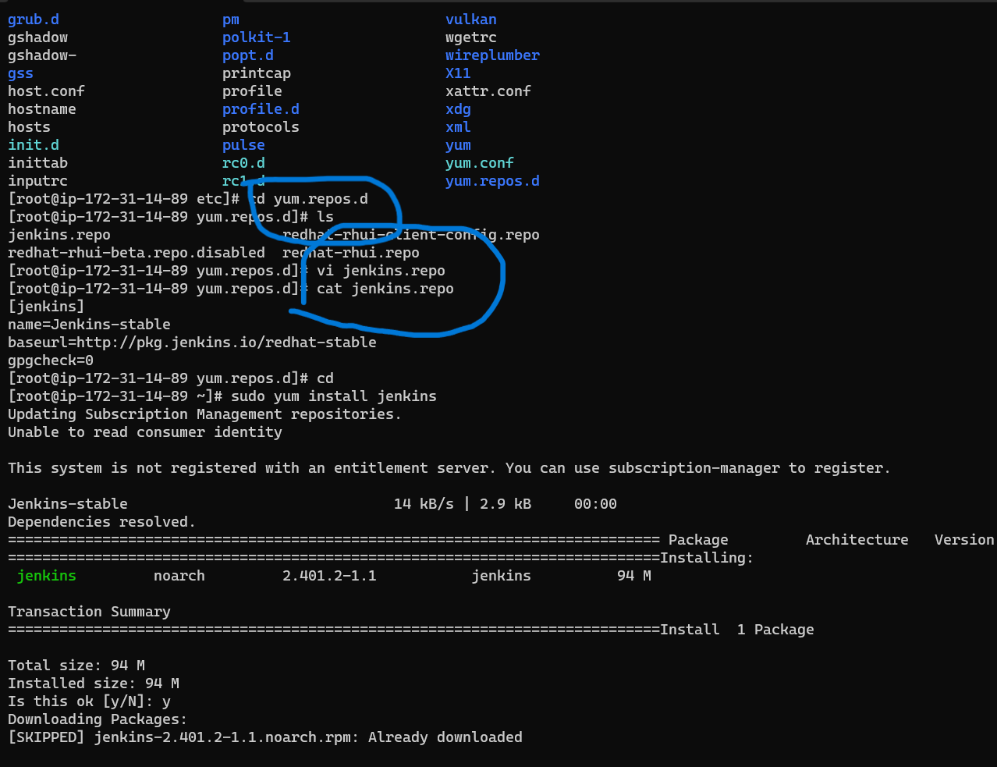
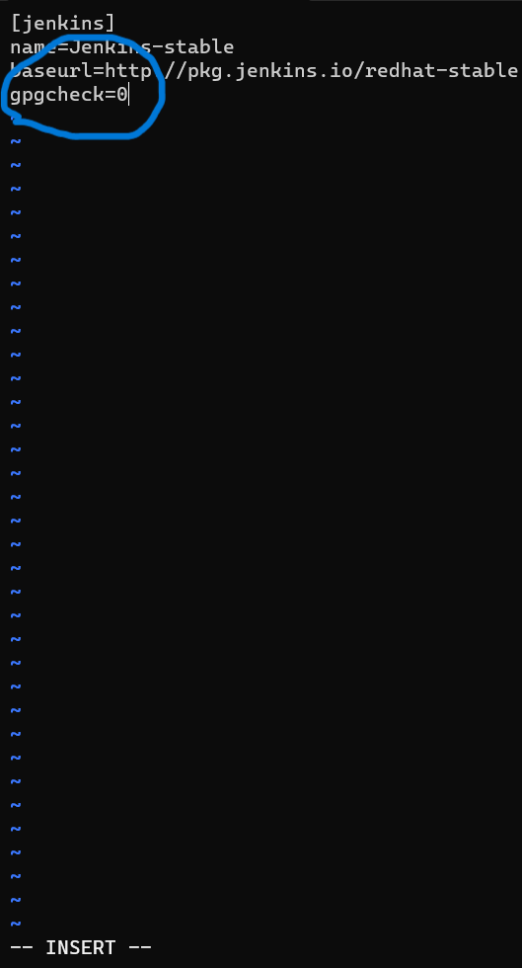
Step 5:- Fix GPG Check
By Defulte here is 1 replace it with 0.

Slide 8
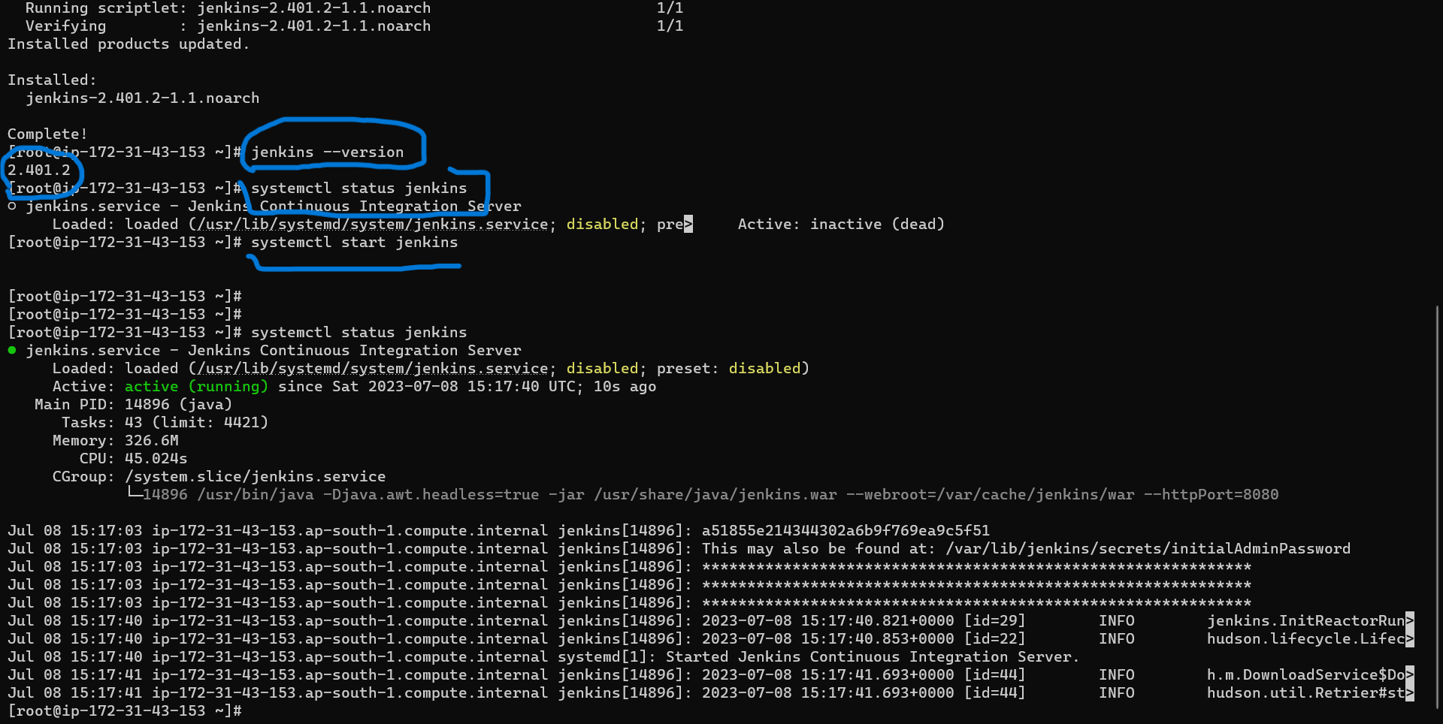
Step 6:- Start Jenkins.

Slide 9
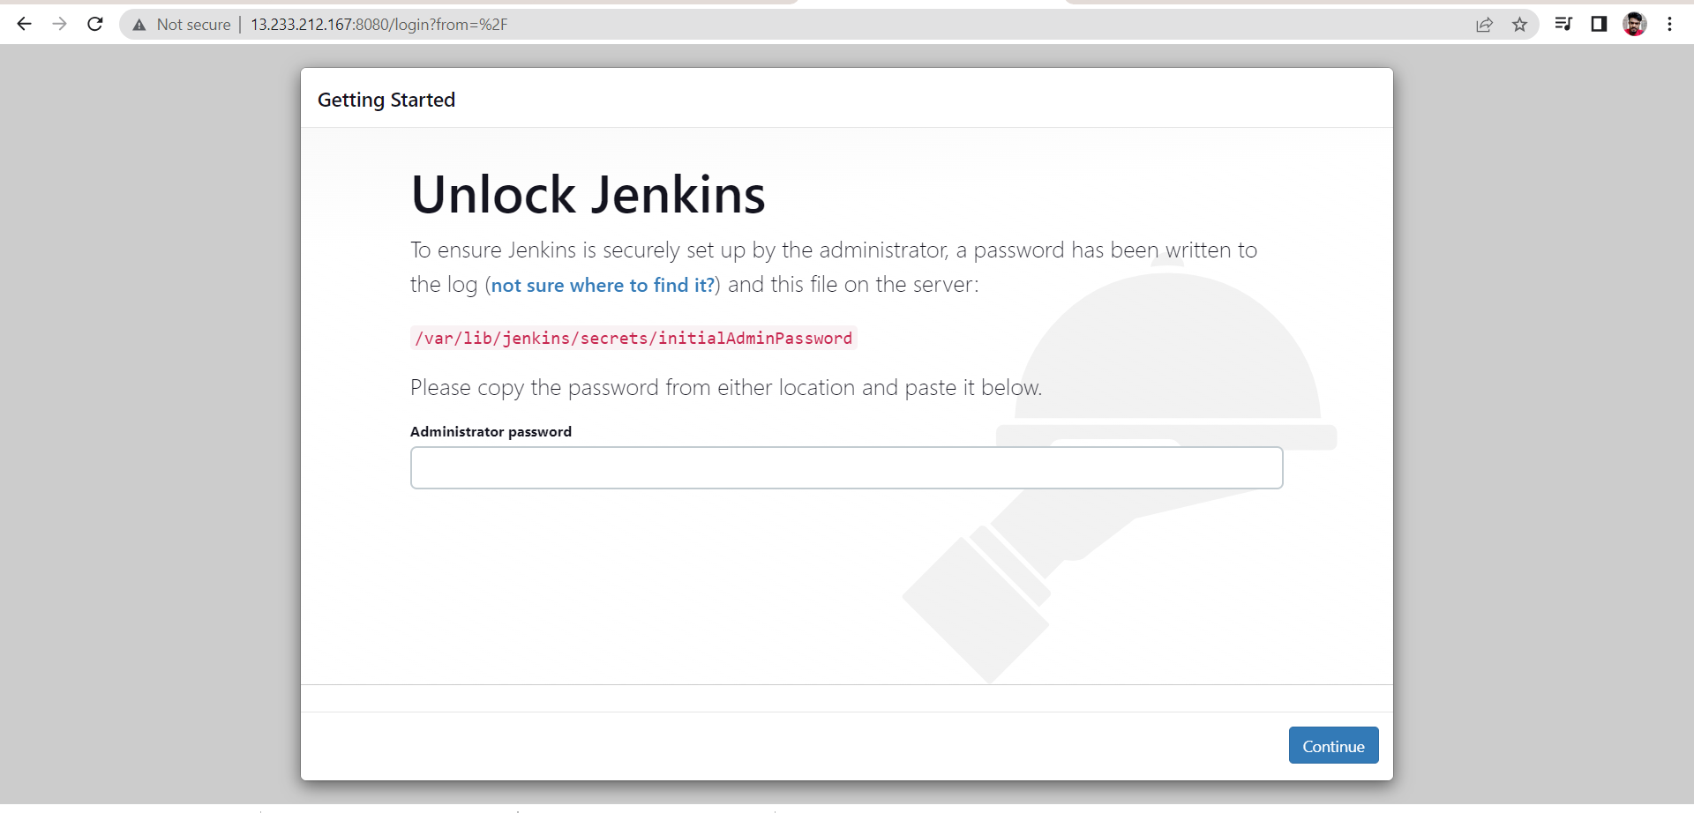
Step 7 :- Now setup Jenkins.

Slide 10
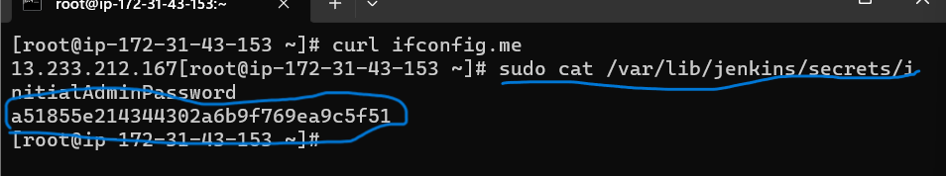
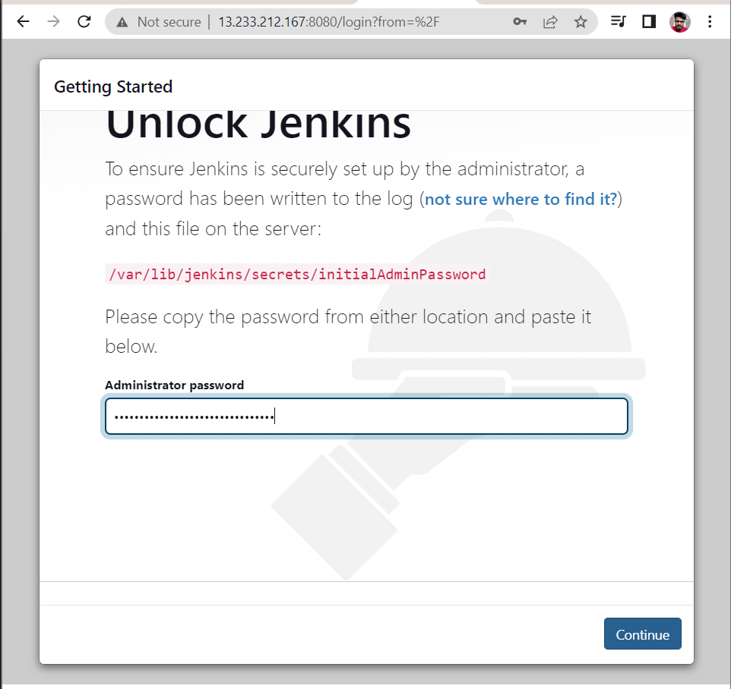
Copy sudo cat /var/lib/jenkins/secrets/initialAdminPassword
and paste in command prompt with sudo cat.
We get password now copy password and paste above.

Slide 11
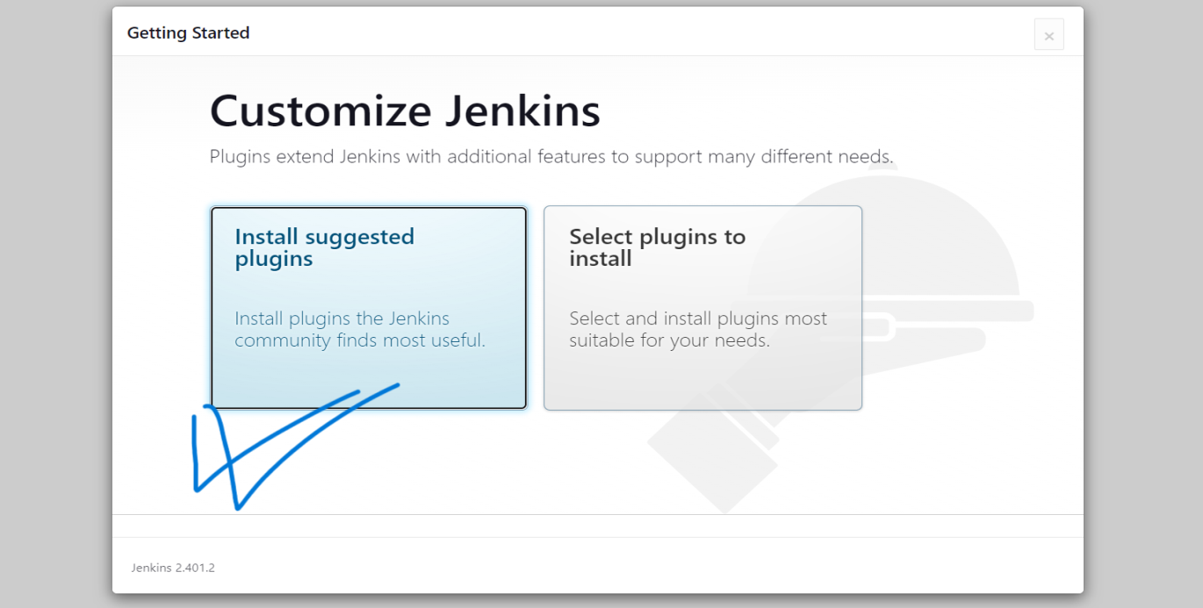
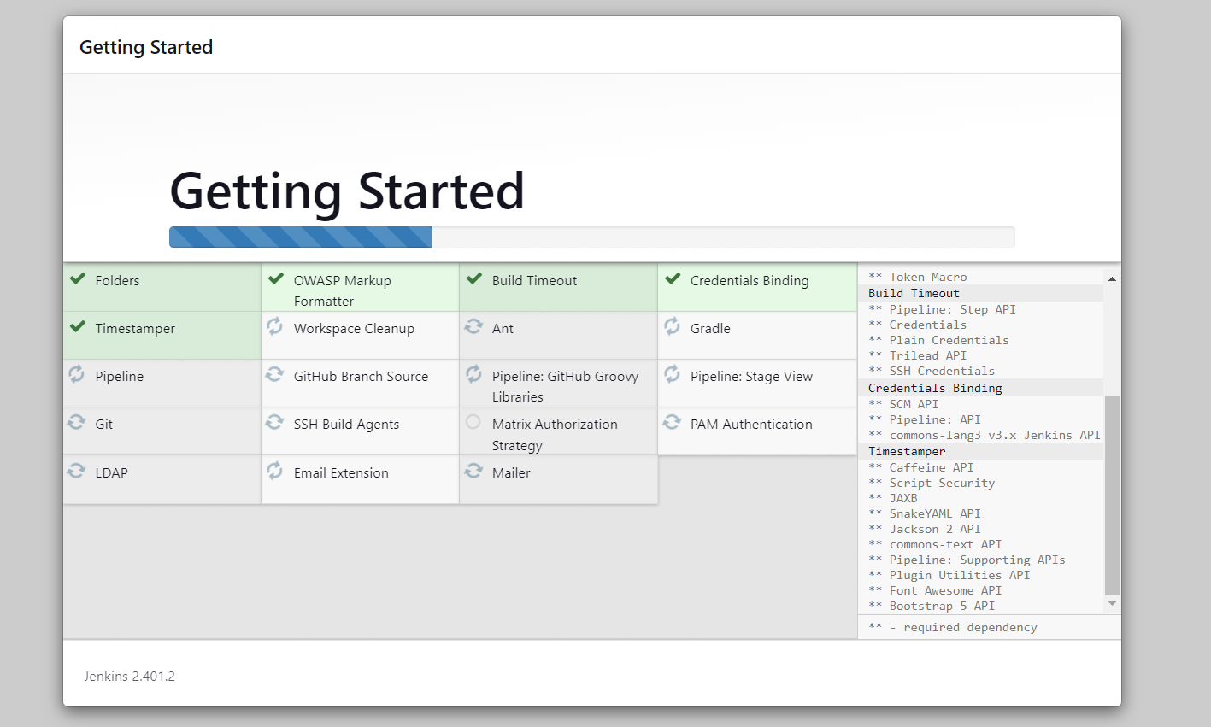

Slide 12
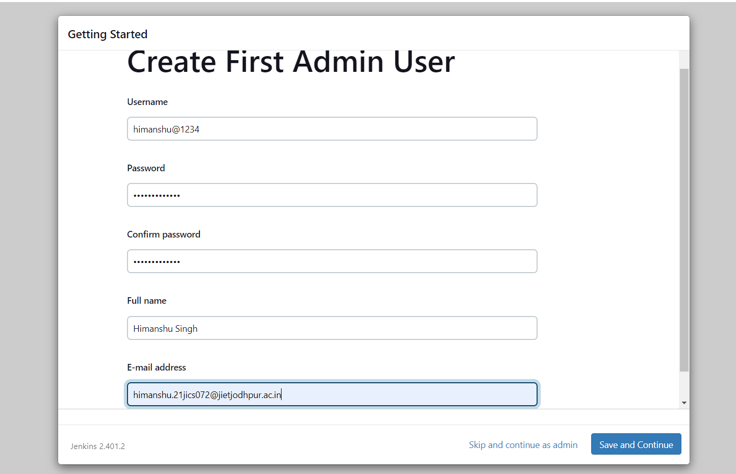
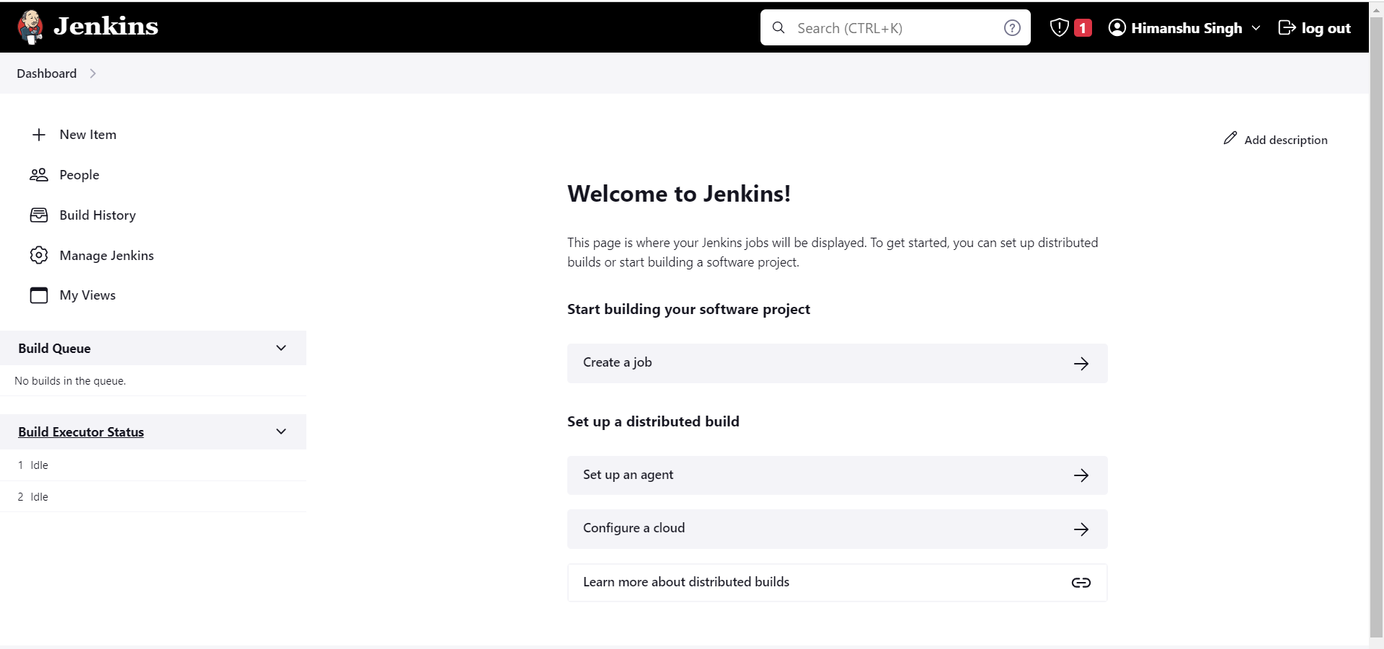
Jenkins is now ready.

Slide 13
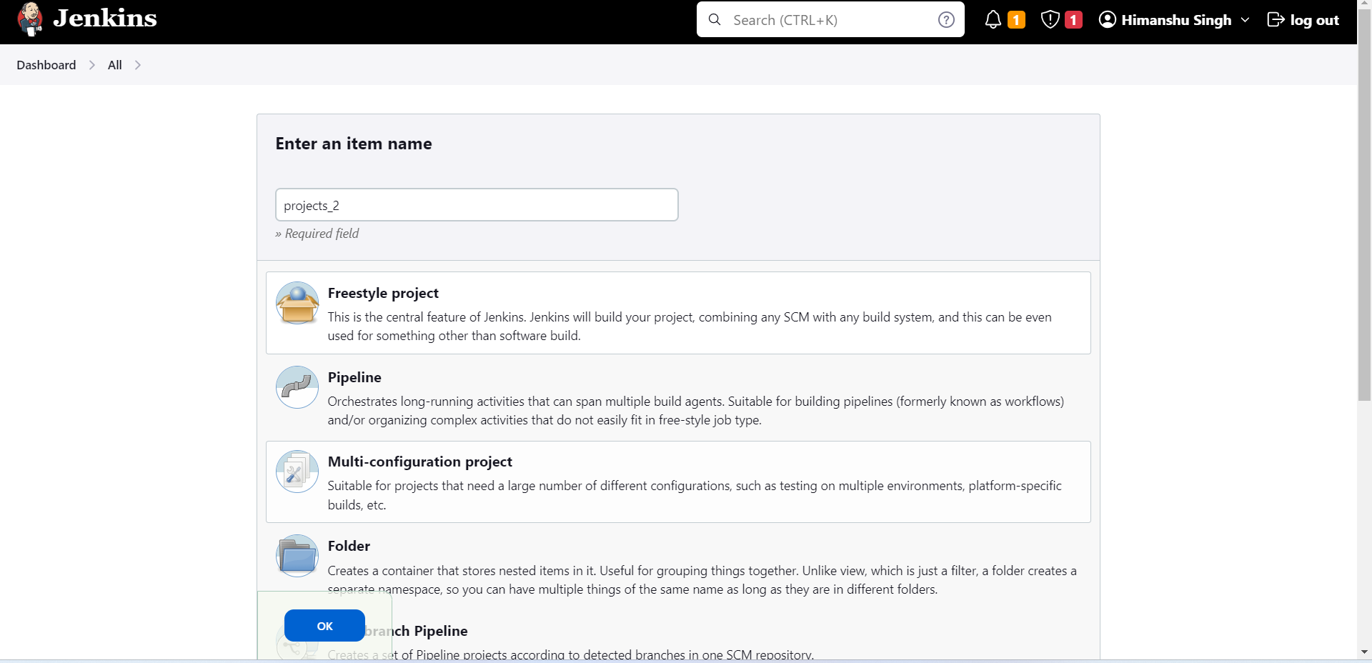

Slide 14
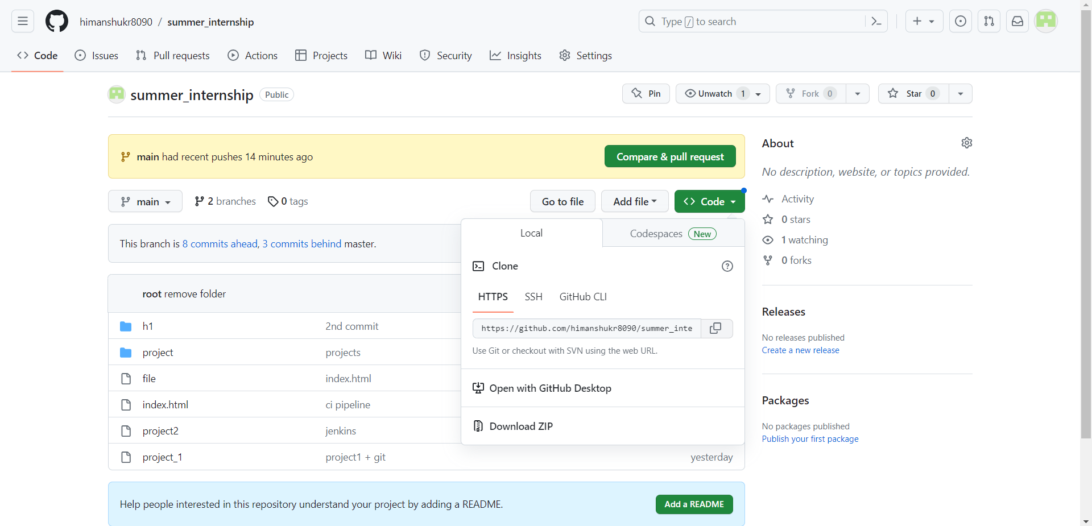

Slide 15
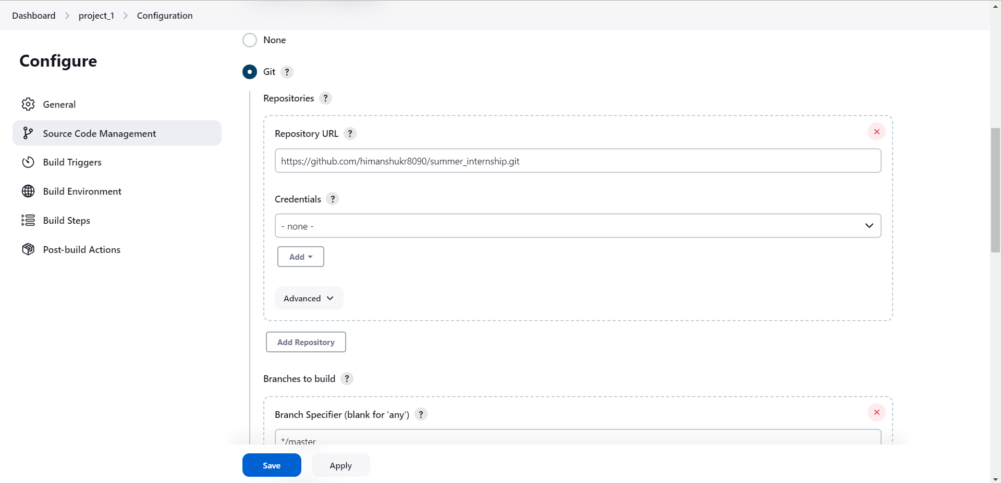

Slide 16
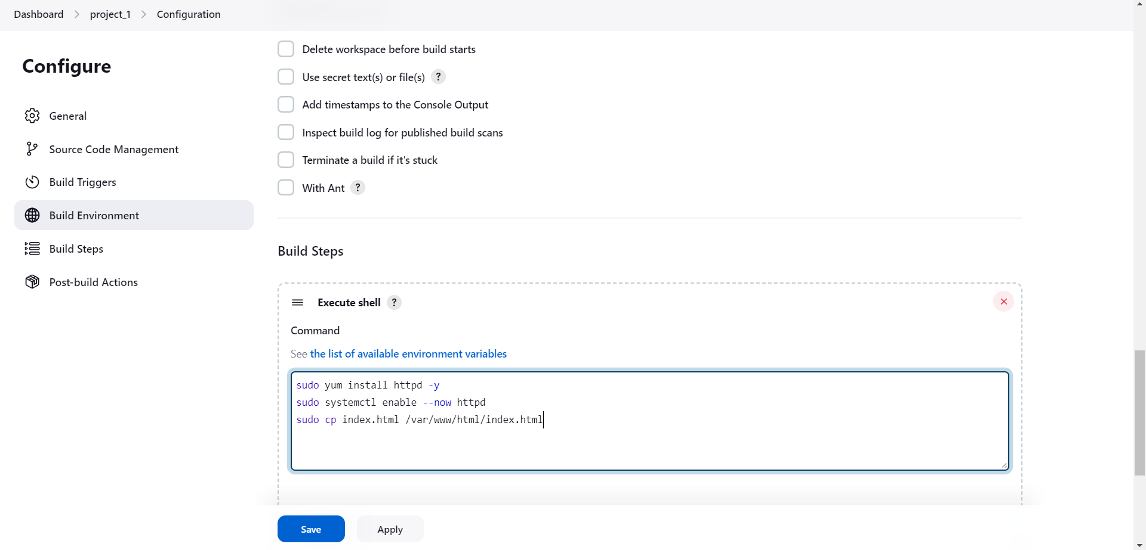

Slide 17
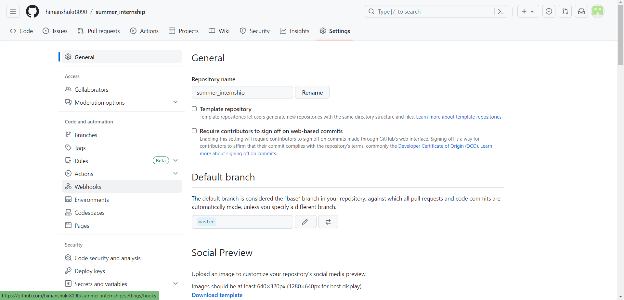

Slide 18
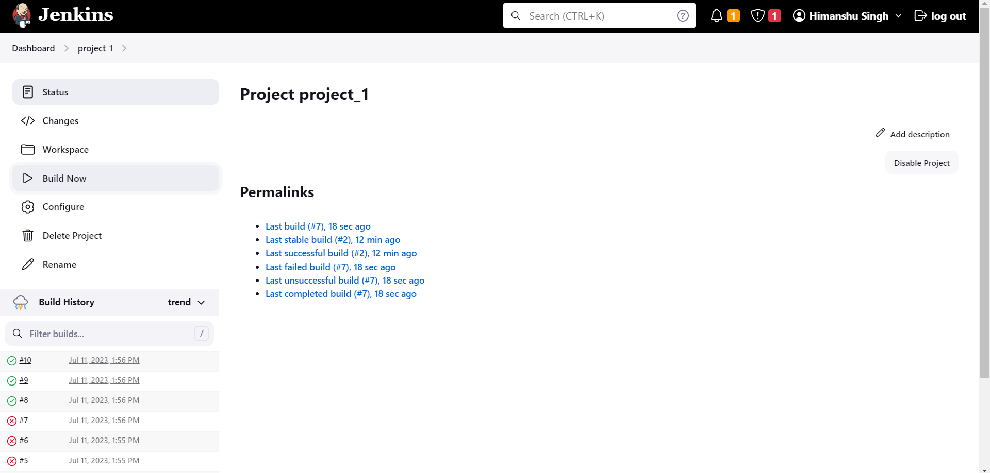

Slide 19

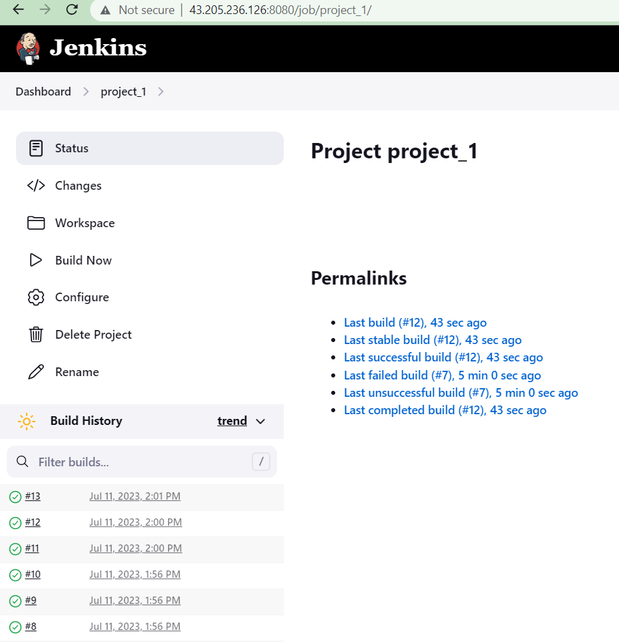


Slide 20
Thank you……

